Slide 1
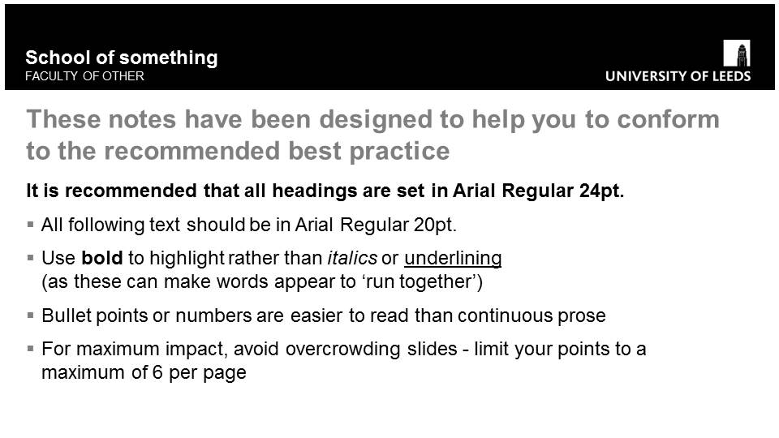
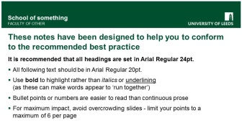
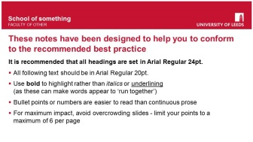
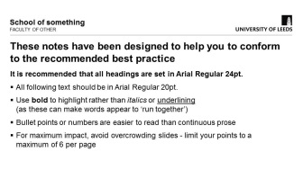
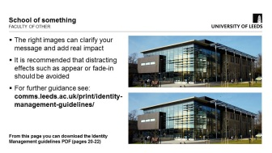
School of something
FACULTY OF OTHER

Slide 2
High contrast colours will help audiences to read text from a distance
This template is available in red, green or black
For further guidance see
www.leeds.ac.uk/identitymanagement

Slide 3
These notes have been designed to help you to conform to the recommended best practice
It is recommended that all headings are set in Arial Regular 24pt.
All following text should be in Arial Regular 20pt.
Use bold to highlight rather than italics or underlining
(as these can make words appear to ‘run together’)
Bullet points or numbers are easier to read than continuous prose
For maximum impact, avoid overcrowding slides - limit your points to a maximum of 6 per page

Slide 4
The right images can clarify your message and add real impact
It is recommended that distracting effects such as appear or fade-in should be avoided
For further guidance see: comms.leeds.ac.uk/print/identity-management-guidelines/
From this page you can download the Identity Management guidelines PDF (pages 20-22)

Slide 5
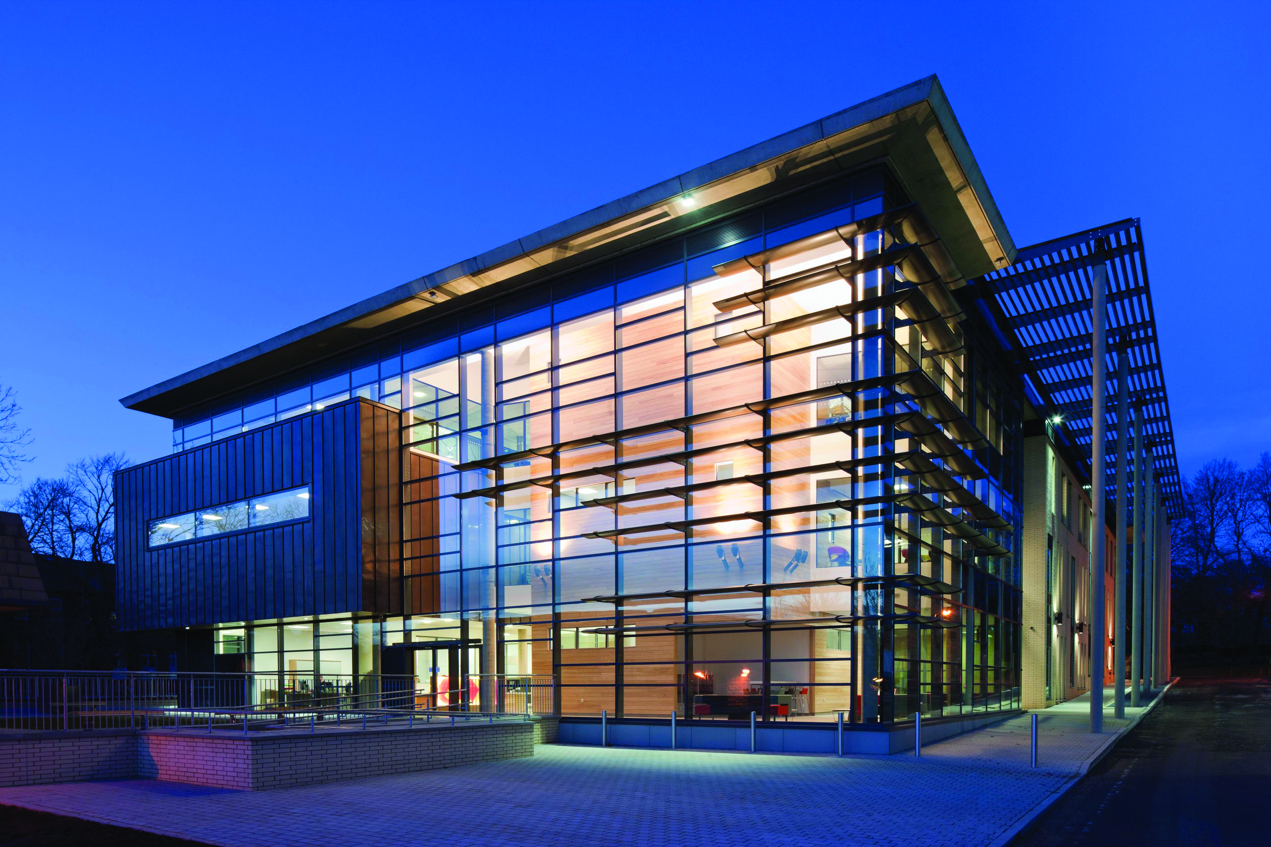
Images should be chosen to
convey that the University is:
Proud of its tradition
Committed to excellence
Modern and future focussed
Dynamic and leading edge
Inspiring
Accessible and inclusive
Professional and customer focused

Slide 7
It is recommended that graphs and tables are kept simple
Colour contrasts help to create clarity in complex diagrams
For further guidance on PowerPoint for teaching purposes see: www.leeds.ac.uk/sddu/online/ powerpoint_for_teaching.htm

Slide 8
Column header row | Column | Column | Column | Column | Column
Row heading | 12 | 120 | 44 | 250 | 49
Row heading | 33 | 304 | 83 | 120 | 135
Row heading | 88 | 200 | 550 | 540 | 310
Row heading | 30 | 16 | 540 | 22 | 643
Row heading | 99 | 66 | 123 | 95 | 67
Row heading | 20 | 33 | 48 | 72 | 734
Row heading | 150 | 86 | 92 | 88 | 77
Row heading | 55 | 20 | 50 | 155 | 93
Row heading | 340 | 490 | 330 | 340 | 11

Slide 9
School of something
FACULTY OF OTHER
High contrast colours will help audiences to read text from a distance
This template is available in red, green or black
For further guidance see
www.leeds.ac.uk/identitymanagement

Slide 10
School of something
FACULTY OF OTHER
These notes have been designed to help you to conform to the recommended best practice
It is recommended that all headings are set in Arial Regular 24pt.
All following text should be in Arial Regular 20pt.
Use bold to highlight rather than italics or underlining
(as these can make words appear to ‘run together’)
Bullet points or numbers are easier to read than continuous prose
For maximum impact, avoid overcrowding slides - limit your points to a maximum of 6 per page

Slide 11
School of something
FACULTY OF OTHER
The right images can clarify your message and add real impact
It is recommended that distracting effects such as appear or fade-in should be avoided
For further guidance see: comms.leeds.ac.uk/print/identity-management-guidelines/
From this page you can download the Identity Management guidelines PDF (pages 20-22)

Slide 12
School of something
FACULTY OF OTHER
Images should be chosen to
convey that the University is:
Proud of its tradition
Committed to excellence
Modern and future focussed
Dynamic and leading edge
Inspiring
Accessible and inclusive
Professional and customer focused

Slide 13
School of something
FACULTY OF OTHER

Slide 14
School of something
FACULTY OF OTHER
It is recommended that graphs and tables are kept simple
Colour contrasts help to create clarity in complex diagrams
For further guidance on PowerPoint for teaching purposes see: www.leeds.ac.uk/sddu/online/ powerpoint_for_teaching.htm

Slide 15
School of something
FACULTY OF OTHER
Column header row | Column | Column | Column | Column | Column
Row heading | 12 | 120 | 44 | 250 | 49
Row heading | 33 | 304 | 83 | 120 | 135
Row heading | 88 | 200 | 550 | 540 | 310
Row heading | 30 | 16 | 540 | 22 | 643
Row heading | 99 | 66 | 123 | 95 | 67
Row heading | 20 | 33 | 48 | 72 | 734
Row heading | 150 | 86 | 92 | 88 | 77
Row heading | 55 | 20 | 50 | 155 | 93
Row heading | 340 | 490 | 330 | 340 | 11

Slide 16
School of something
FACULTY OF OTHER
High contrast colours will help audiences to read text from a distance
This template is available in red, green or black
For further guidance see
www.leeds.ac.uk/identitymanagement

Slide 17
School of something
FACULTY OF OTHER
These notes have been designed to help you to conform to the recommended best practice
It is recommended that all headings are set in Arial Regular 24pt.
All following text should be in Arial Regular 20pt.
Use bold to highlight rather than italics or underlining
(as these can make words appear to ‘run together’)
Bullet points or numbers are easier to read than continuous prose
For maximum impact, avoid overcrowding slides - limit your points to a maximum of 6 per page

Slide 18
School of something
FACULTY OF OTHER
The right images can clarify your message and add real impact
It is recommended that distracting effects such as appear or fade-in should be avoided
For further guidance see: comms.leeds.ac.uk/print/identity-management-guidelines/
From this page you can download the Identity Management guidelines PDF (pages 20-22)

Slide 19
School of something
FACULTY OF OTHER
Images should be chosen to
convey that the University is:
Proud of its tradition
Committed to excellence
Modern and future focussed
Dynamic and leading edge
Inspiring
Accessible and inclusive
Professional and customer focused

Slide 20
School of something
FACULTY OF OTHER

Slide 21
School of something
FACULTY OF OTHER
It is recommended that graphs and tables are kept simple
Colour contrasts help to create clarity in complex diagrams
For further guidance on PowerPoint for teaching purposes see: www.leeds.ac.uk/sddu/online/ powerpoint_for_teaching.htm

Slide 22
School of something
FACULTY OF OTHER
Column header row | Column | Column | Column | Column | Column
Row heading | 12 | 120 | 44 | 250 | 49
Row heading | 33 | 304 | 83 | 120 | 135
Row heading | 88 | 200 | 550 | 540 | 310
Row heading | 30 | 16 | 540 | 22 | 643
Row heading | 99 | 66 | 123 | 95 | 67
Row heading | 20 | 33 | 48 | 72 | 734
Row heading | 150 | 86 | 92 | 88 | 77
Row heading | 55 | 20 | 50 | 155 | 93
Row heading | 340 | 490 | 330 | 340 | 11

Slide 23
School of something
FACULTY OF OTHER
High contrast colours will help audiences to read text from a distance
This template is available in red, green or black
For further guidance see
www.leeds.ac.uk/identitymanagement

Slide 24
School of something
FACULTY OF OTHER
These notes have been designed to help you to conform to the recommended best practice
It is recommended that all headings are set in Arial Regular 24pt.
All following text should be in Arial Regular 20pt.
Use bold to highlight rather than italics or underlining
(as these can make words appear to ‘run together’)
Bullet points or numbers are easier to read than continuous prose
For maximum impact, avoid overcrowding slides - limit your points to a maximum of 6 per page

Slide 25
School of something
FACULTY OF OTHER
The right images can clarify your message and add real impact
It is recommended that distracting effects such as appear or fade-in should be avoided
For further guidance see: comms.leeds.ac.uk/print/identity-management-guidelines/
From this page you can download the Identity Management guidelines PDF (pages 20-22)

Slide 26
School of something
FACULTY OF OTHER
Images should be chosen to
convey that the University is:
Proud of its tradition
Committed to excellence
Modern and future focussed
Dynamic and leading edge
Inspiring
Accessible and inclusive
Professional and customer focused

Slide 27
School of something
FACULTY OF OTHER

Slide 28
School of something
FACULTY OF OTHER
It is recommended that graphs and tables are kept simple
Colour contrasts help to create clarity in complex diagrams
For further guidance on PowerPoint for teaching purposes see: www.leeds.ac.uk/sddu/online/ powerpoint_for_teaching.htm

Slide 29
School of something
FACULTY OF OTHER
Column header row | Column | Column | Column | Column | Column
Row heading | 12 | 120 | 44 | 250 | 49
Row heading | 33 | 304 | 83 | 120 | 135
Row heading | 88 | 200 | 550 | 540 | 310
Row heading | 30 | 16 | 540 | 22 | 643
Row heading | 99 | 66 | 123 | 95 | 67
Row heading | 20 | 33 | 48 | 72 | 734
Row heading | 150 | 86 | 92 | 88 | 77
Row heading | 55 | 20 | 50 | 155 | 93
Row heading | 340 | 490 | 330 | 340 | 11

